Slide 1


Christian Fernandez
6/1/2022

Slide 2

Outline
Executive Summary
Introduction
Methodology
Results
Conclusion
Appendix

Slide 3
Executive Summary
Summary of methodologies
For data collection, both API’s and Web Scraping applications were used. Once collected, data wrangling was done to prepare it for analysis. Exploratory data analysis was done using SQL and with visualization libraries such as Matplotlib and Seaborn. Interactive visual analysis of locations was also done using the Folium library in order to map coordinates. To conclude, a machine learning prediction was built using classification methods.
Summary of all results
Exploratory Data Analysis showed which features led to the most successful launches.
Screenshots of the interactive analytics in Folium showed launch site locations.
The predictive analytics results gave the best model to predict successful launches.

Slide 4
Introduction
Project background and context
Space X advertises Falcon 9 rocket launches on its website with a cost of 62 million dollars; other providers cost upward of 165 million dollars each, much of the savings is because Space X can reuse the first stage. Therefore, if we can determine if the first stage will land, we can determine the cost of a launch. This information can be used if an alternate company wants to bid against space X for a rocket launch. This goal of the project is to create a machine learning pipeline to predict if the first stage will land successfully for new company and SpaceX competitor, SpaceY.
Problems to solve
We will look to determine which factors will lead to the rocket landing successfully, the interaction amongst various features that determine the success rate of a successful landing and what operating conditions needs to be in place to ensure a successful landing program.

Slide 5

Section 1

Slide 6
Methodology
Executive Summary
Data collection methodology:
Data was collected using SpaceX API and web scraping from Wikipedia.
Perform data wrangling
Created a landing outcome label based on outcome data and replaced missing values with the mean of the Payload Mass column.
Perform exploratory data analysis (EDA) using visualization and SQL
Perform interactive visual analytics using Folium and Plotly Dash
Perform predictive analysis using classification models
Collected data was normalized, split into training and test sets and evaluated using four different classification models. The accuracy of each model was compared to the others using different combinations of parameters.

Slide 7
Data Collection
Describe how data sets were collected.
Data collection was done by using a GET request to the SpaceX API (https://api.spacexdata.com/v4/rockets). The data was then decoded into json format and normalized and turned into a Pandas data frame. We also acquired data by web scraping the Wikipedia page for Falcon 9 launch records (https://en.wikipedia.org/wiki/List_of_Falcon\_9\_and_Falcon_Heavy_launches) using the Beautiful Soup tool which was parsed and converted into a Pandas data frame.
The data was then subsequently cleaned, checked for and filled in missing values.

Slide 8
Data Collection – SpaceX API
SpaceX public API featuring all of its launch records was used for this section of the project.
Source Code:
https://github.com/ChrisF03/IBM-Data-Science-Capstone/blob/master/Data%20Collection%20API.ipynb
Request API and parse the data.
Filter data to only include Falcon 9 launches.
1
2
Replace missing values.
3

Slide 9
Data Collection - Scraping
Data from SpaceX Falcon 9 launches from a table on the Wikipedia page.
Data was parsed and then committed to a Pandas data frame.
Source Code:
https://github.com/ChrisF03/IBM-Data-Science-Capstone/blob/master/Data%20Collection%20with%20Web%20Scraping.ipynb
Used GET request to parse Falcon 9 Wikipedia page.
Extract column names and headers from HTML page.
Parse table elements and commit them to Pandas data frame.

Slide 10
Data Wrangling
After some initial analysis of the dataset, we created a landing outcome column based on the outcome column. In the new ‘Landing Outcome’ column, success were labeled as ‘1’ and failures as ‘0’.
Summaries for launches per site, occurrences of each orbit and occurrences of mission outcome per orbit were also queried.
Exploratory Analysis
One-hot Encoding of Outcomes
Summaries
1
2
3

Slide 11
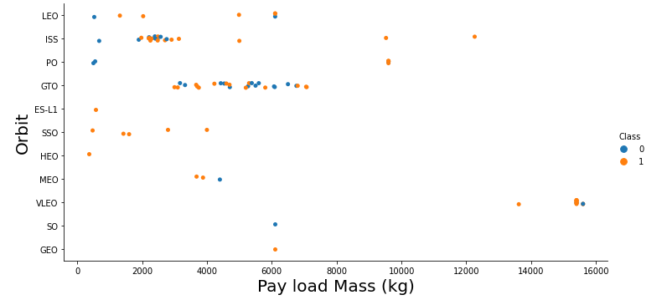
EDA with Data Visualization
In our analysis, scatterplots and barplots were used to visualize the relationships between features.
Source Code : https://github.com/ChrisF03/IBM-Data-Science-Capstone/blob/master/EDA%20with%20Visualization.ipynb

Slide 12
EDA with SQL
Using SQL, the following queries were performed:
The names of unique launch sites in the space mission.
5 records where launch sites begin with the string 'CCA’.
The total payload mass carried by boosters launched by NASA (CRS).
The average payload mass carried by booster version F9 v1.1
the date when the first succesful landing outcome in ground pad was achieved.
the names of the boosters which have success in drone ship and have payload mass between 4000 and 6000.
The total number of successful and failure mission outcomes.
The failed landing outcomes in drone ship, their booster version and launch site names.
Source Code: https://github.com/ChrisF03/IBM-Data-Science-Capstone/blob/master/EDA%20with%20SQL.ipynb

Slide 13
Build an Interactive Map with Folium
Circles, markers, and lines and were used on our Folium Map highlighting the launch sites.
The circles highlighted launch locations such as the NASA Johnson Space Center.
Markers were used in clusters for each location to represent the successful and failed launches for each site on the map.
Lines were used to calculate the distances between a launch site to its proximities.
Source Code: https://github.com/ChrisF03/IBM-Data-Science-Capstone/blob/master/Interactive%20Visual%20Analytics%20with%20Folium%20lab.ipynb

Slide 14
Build a Dashboard with Plotly Dash
Pie charts showing the total launches by a certain sites and a scatter graph showing the relationship with Outcome and Payload Mass (Kg) for the different booster version.
Sliders and dropdown menus were used as interactive components.
Source code: https://github.com/ChrisF03/IBM-Data-Science-Capstone/blob/master/Interactive%20Dashboard%20with%20Ploty%20Dash%20(IBM-SpaceX).py

Slide 15
Predictive Analysis (Classification)
For our predictive analysis, four classification models were built and compared.
The models were logistic regression, support vector machine, decision tree and K-Nearest-Neighbors.
Source code: https://github.com/ChrisF03/IBM-Data-Science-Capstone/blob/master/Landing%20Prediction.ipynb
Test of each model with unique combination of hyperparameters.
Data prep and Standardization
Comparison of results

Slide 16
Results
Exploratory data analysis results:
SpaceX uses 4 distinct launch sites.
The average payload mass carried by booster version F9 v1.1 is 6,138.29 kg.
The first successful landing on a ground pad was on January 5, 2017.
98% of missions are successful.
Success rate has been increasing since 2013.

Slide 17
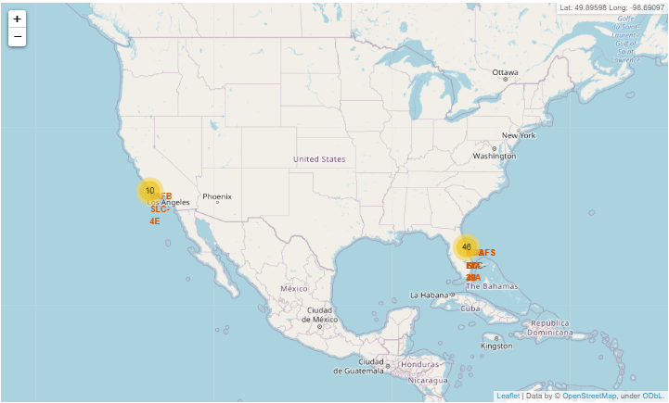
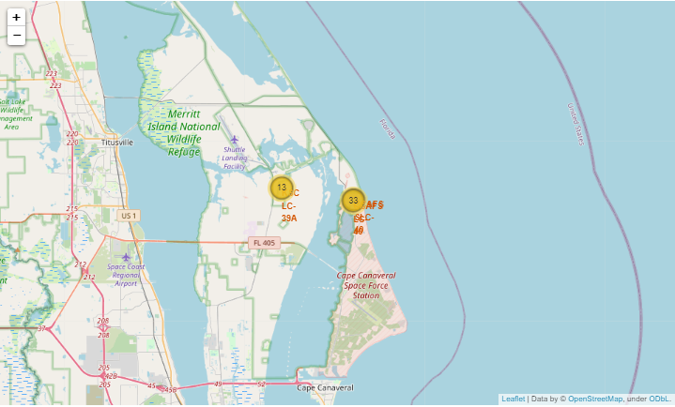
Results
Using the Folium library, we were able to generate interactive maps of the launch sites used by SpaceX.
Launch sites are right on the east and west coastlines of the U.S and are maintained far away from population centers and near logistical infrastructure.
Interactive analytics demo in screenshots:

Slide 18
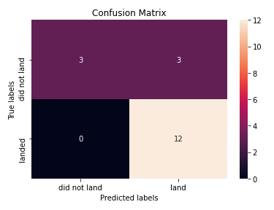
Results
Predictive analysis results:
Our predictive analysis entailed four different classification models that were to be built and compared.
All of the methods used returned a near-identical score around 0.83-0.84 except for the Decision Tree method which returned an accuracy score of about 0.87.

Slide 19

Section 2

Slide 20
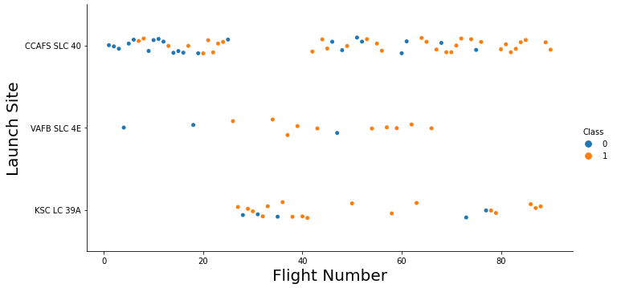
Flight Number vs. Launch Site
Looking at the chart, we can see that the most successful and most used launch site is CCAFS SLC 40.
VAFB SLC 4E is the least used.
Launches were succeeded at a higher rate over time.

Slide 21
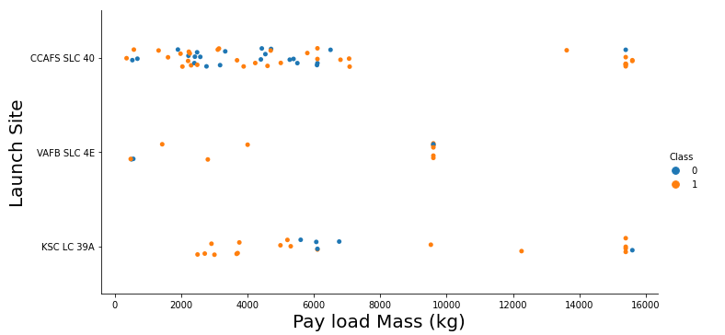
Payload vs. Launch Site
The mass of the majority of Payloads is below 8,000 kg.
Payloads over 9,000 kg are highly successful, however.
Launch site VAFB SLC 4E seems to max out at that 9,000 kg threshold which may have something to do with why it is the least used.

Slide 22
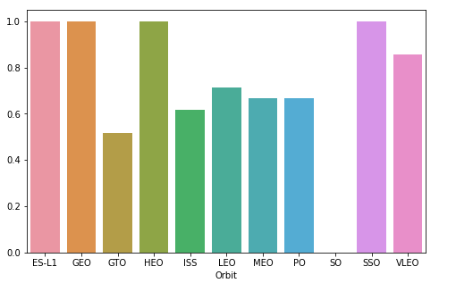
Success Rate vs. Orbit Type
The highest success rates are 100% and are in the following orbits:
ES-L1
GEO
HEO
SSO
VLEO orbit has the second highest success rate, at over 80%.

Slide 23
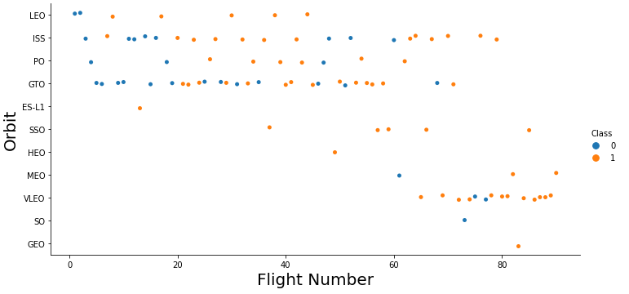
Flight Number vs. Orbit Type
From the graph we can see that success rate increased with the number of flights.
Most flights are flown in GTO orbit.
VLEO, SO, and GEO orbit launches appear to be new ventures within in the industry.

Slide 24
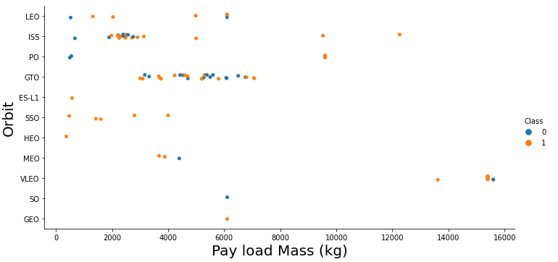
Payload vs. Orbit Type
ISS orbit has the broadest range of payload mass, although most of its payloads were around 2,000 kg.
VLEO orbit, while one of the least used launches, has carried the heaviest payloads.
GTO payloads max out at just under 8,000 kg.

Slide 25
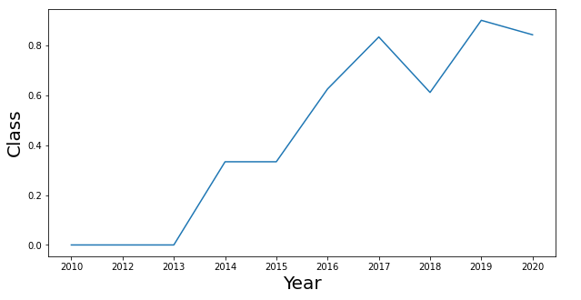
Launch Success Yearly Trend
All launches failed in the first three years.
Launches have been succeeding at an increasing rate since 2013.
So far, 2019 was the most successful year for SpaceX launches.

Slide 26
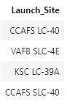
All Launch Site Names
According to our dataset, there are four distinct launch sites used by SpaceX:
These are returned by selecting “distinct” launch_site.

Slide 27
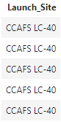
Launch Site Names Begin with 'CCA'
Here we can see 5 launches beginning with CCA, which represents Cape Caneveral.

Slide 28
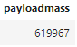
Total Payload Mass
Below is the total payload mass carried by boosters launched by NASA (CRS):
This is calculated by summing the mass of all payloads who have CRS in the name which corresponds to NASA.

Slide 29
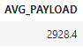
Average Payload Mass by F9 v1.1
Average payload mass carried by booster version F9 v1.1:

Slide 30
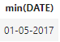
First Successful Ground Landing Date
The first successful landing on a ground pad was achieved on :
This was returned by filtering landing outcome by success on ground pad and finding the minimum date.

Slide 31
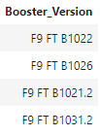
Successful Drone Ship Landing with Payload between 4000 and 6000
Boosters which have successfully landed on drone ship and had payload mass greater than 4000 but less than 6000 are listed below :

Slide 32
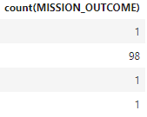
Total Number of Successful and Failure Mission Outcomes
Number of successful and failed missions is shown below :

Slide 33
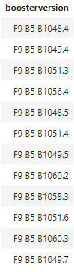
Boosters Carried Maximum Payload
Booster which have carried maximum payload mass are as follows:

Slide 34
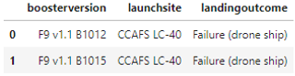
2015 Launch Records
The failed landing outcomes in drone ship, their booster versions, and launch site names for year 2015 are show below:

Slide 35
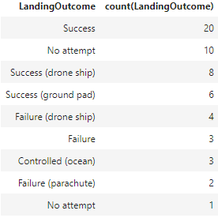
Rank Landing Outcomes Between 2010-06-04 and 2017-03-20
Ranks of landing outcomes (such as Failure (drone ship) or Success (ground pad)) between the date 2010-06-04 and 2017-03-20, in descending order:

Slide 36

Section 3

Slide 37
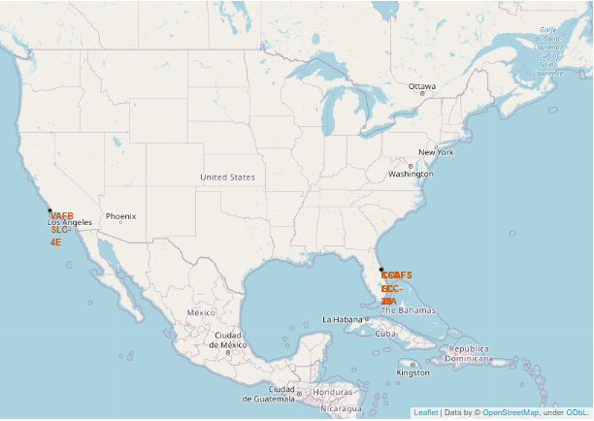
Launch Site Locations
Launch sites are right on the coasts of the U.S, away from population centers and near important infrastructure such as roads and railroads.

Slide 38
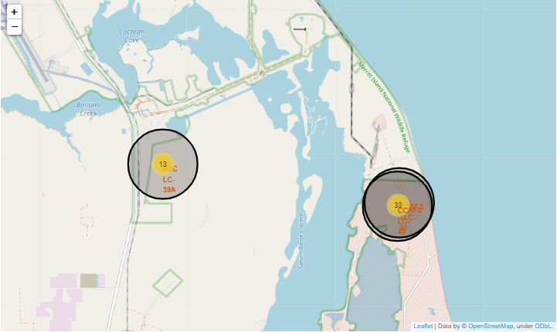
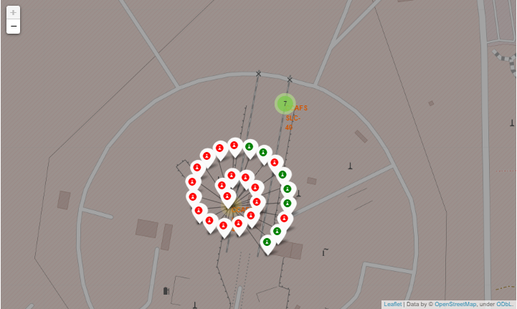
Launch Outcomes
Here we see two launch sites on the east coast in Florida.
The green and red markers represent successes and failures at the CCAFS SLC-40 launch site.

Slide 39
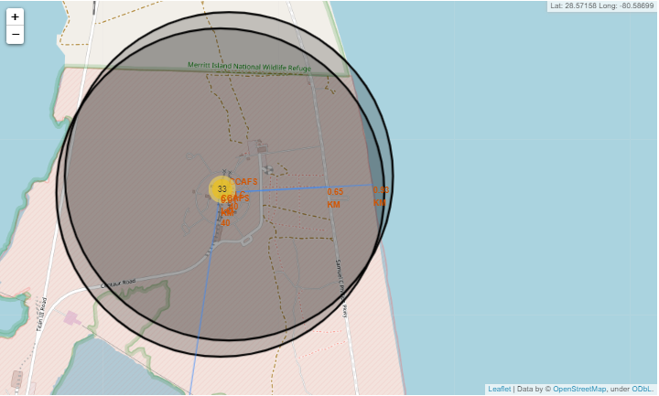
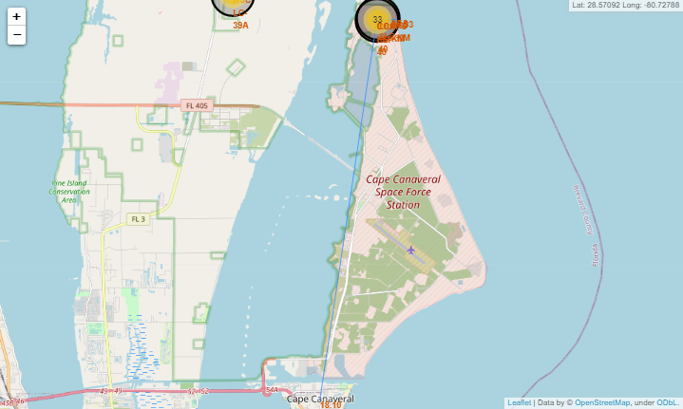
Logistics
Here we can see how close launch site CCAFS SLC-40 is to the coastline. 3
We can also see how far away from the nearest city it is. The nearest population center being Cape Canaveral.

Slide 40

Section 4

Slide 41
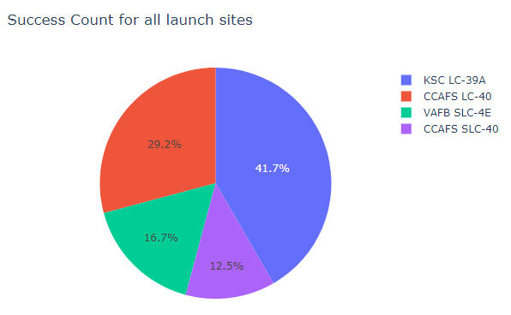
Success Rate For Each Site
Launch site KSC LC-39A has the highest success rate of any location.
CCAFS SLC-40 has the lowest.

Slide 42
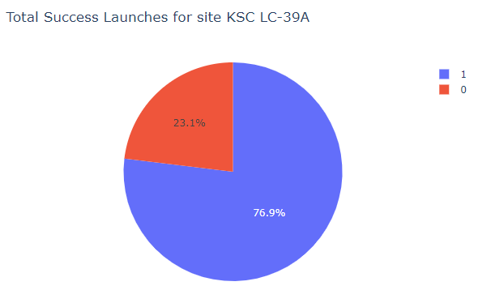
Highest Success Ratio
Launch site KSC LC-39A has a near 80% success rate.

Slide 43
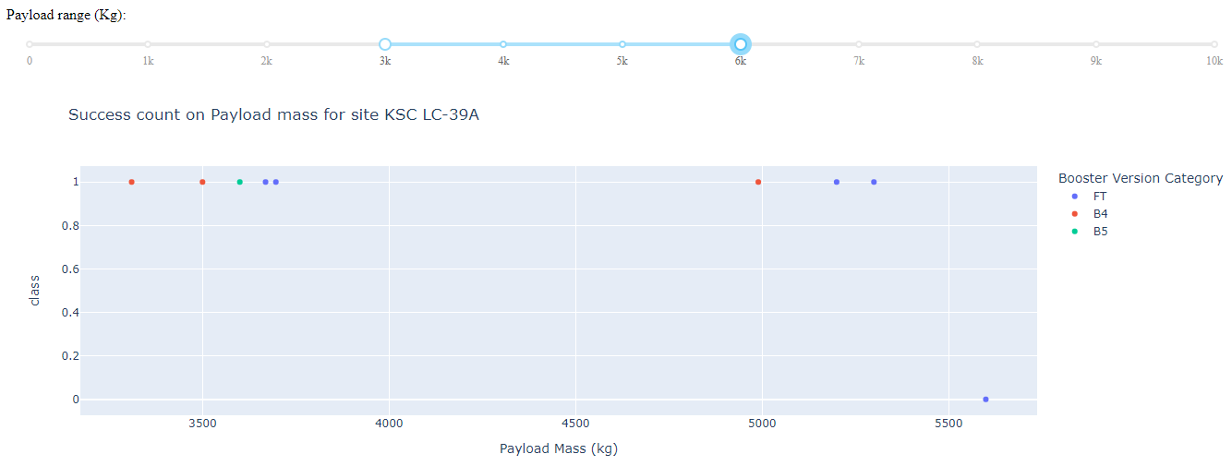
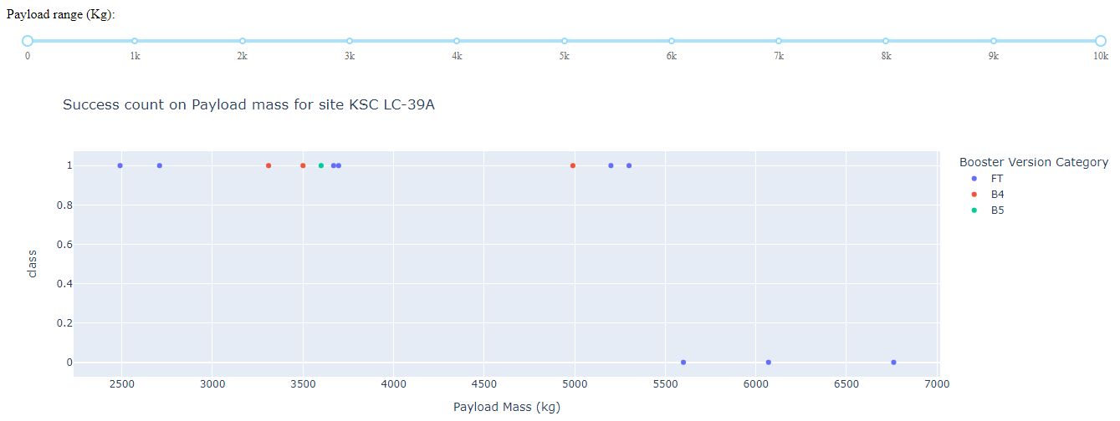
Payload Mass and Launch Outcomes
Payload masses under 5,500 kg are always successful.
There have been very few attempts at payload masses over that 5,500 kg threshold and none have succeeded.

Slide 44

Section 5

Slide 45
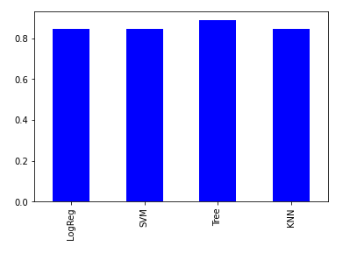
Classification Accuracy
The Decision Tree method has the highest accuracy rate.

Slide 46
Confusion Matrix
The confusion matrix of the Decision Tree classifier shows its accuracy by showing the high number of right predictions in the bottom right.

Slide 47
Conclusions
The best launch site is KSC LC-39A.
Most launches have a payload mass below 8,000 kg.
While less frequent, higher payload masses (>7,000 kg) have a higher success rate.
Launch sites are kept away from population centers.
Decision Tree Classifier is the best method to predict successful landings.

Slide 48


